Slide 1
Shellcoding
Introduction
Yan Shoshitaishvili
Arizona State University

Slide 2
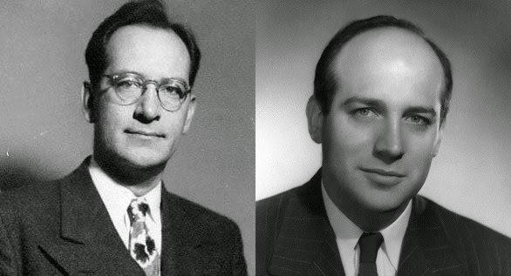

John Mauchly (Physicist), John Presper Eckert (Electrical Engineer), John Von Neumann (Mathematician)
John von Neumann, First Draft of a Report on the EDVAC, 1945.

Slide 3
Von Neumann Architecture vs Harvard Architecture
A Von Neumann architecture sees (and stores) code as data.
A Harvard architecture stores data and code separately.
Almost all general-purpose architectures (x86, ARM, MIPS, PPC, SPARC, etc) are Von Neumann.
Harvard architectures pop up in embedded use-cases (AVR, PIC).
What happens if data and code get mixed up?

Slide 4
How does shellcode get injected?
void bye1() { puts("Goodbye!"); }
void bye2() { puts("Farewell!"); }
void hello(char *name, void (*bye_func)()) { printf("Hello %s!\n", name); bye_func(); }
int main(int argc, char **argv) { char name[1024]; gets(name);
srand(time(0)); if (rand() % 2) hello(bye1, name); else hello(name, bye2); }
Compile with: gcc -z execstack -o hello hello.c

Slide 5
How does shellcode get injected?
void bye1() { puts("Goodbye!"); }
void bye2() { puts("Farewell!"); }
void hello(char *name, void (*bye_func)()) { printf("Hello %s!\n", name); bye_func(); }
int main(int argc, char **argv) { char name[1024]; gets(name);
srand(time(0)); if (rand() % 2) hello(bye1, name); else hello(name, bye2); }
Compile with: gcc -z execstack -o hello hello.c

Slide 6
How does shellcode get injected?
void bye1() { puts("Goodbye!"); }
void bye2() { puts("Farewell!"); }
void hello(char *name, void (*bye_func)()) { printf("Hello %s!\n", name); bye_func(); }
int main(int argc, char **argv) { char name[1024]; gets(name);
srand(time(0)); if (rand() % 2) hello(bye1, name); else hello(name, bye2); }
Compile with: gcc -z execstack -o hello hello.c
PROCESS MEMORY
.text
.bss
bye_func();
stack
heap

Slide 7
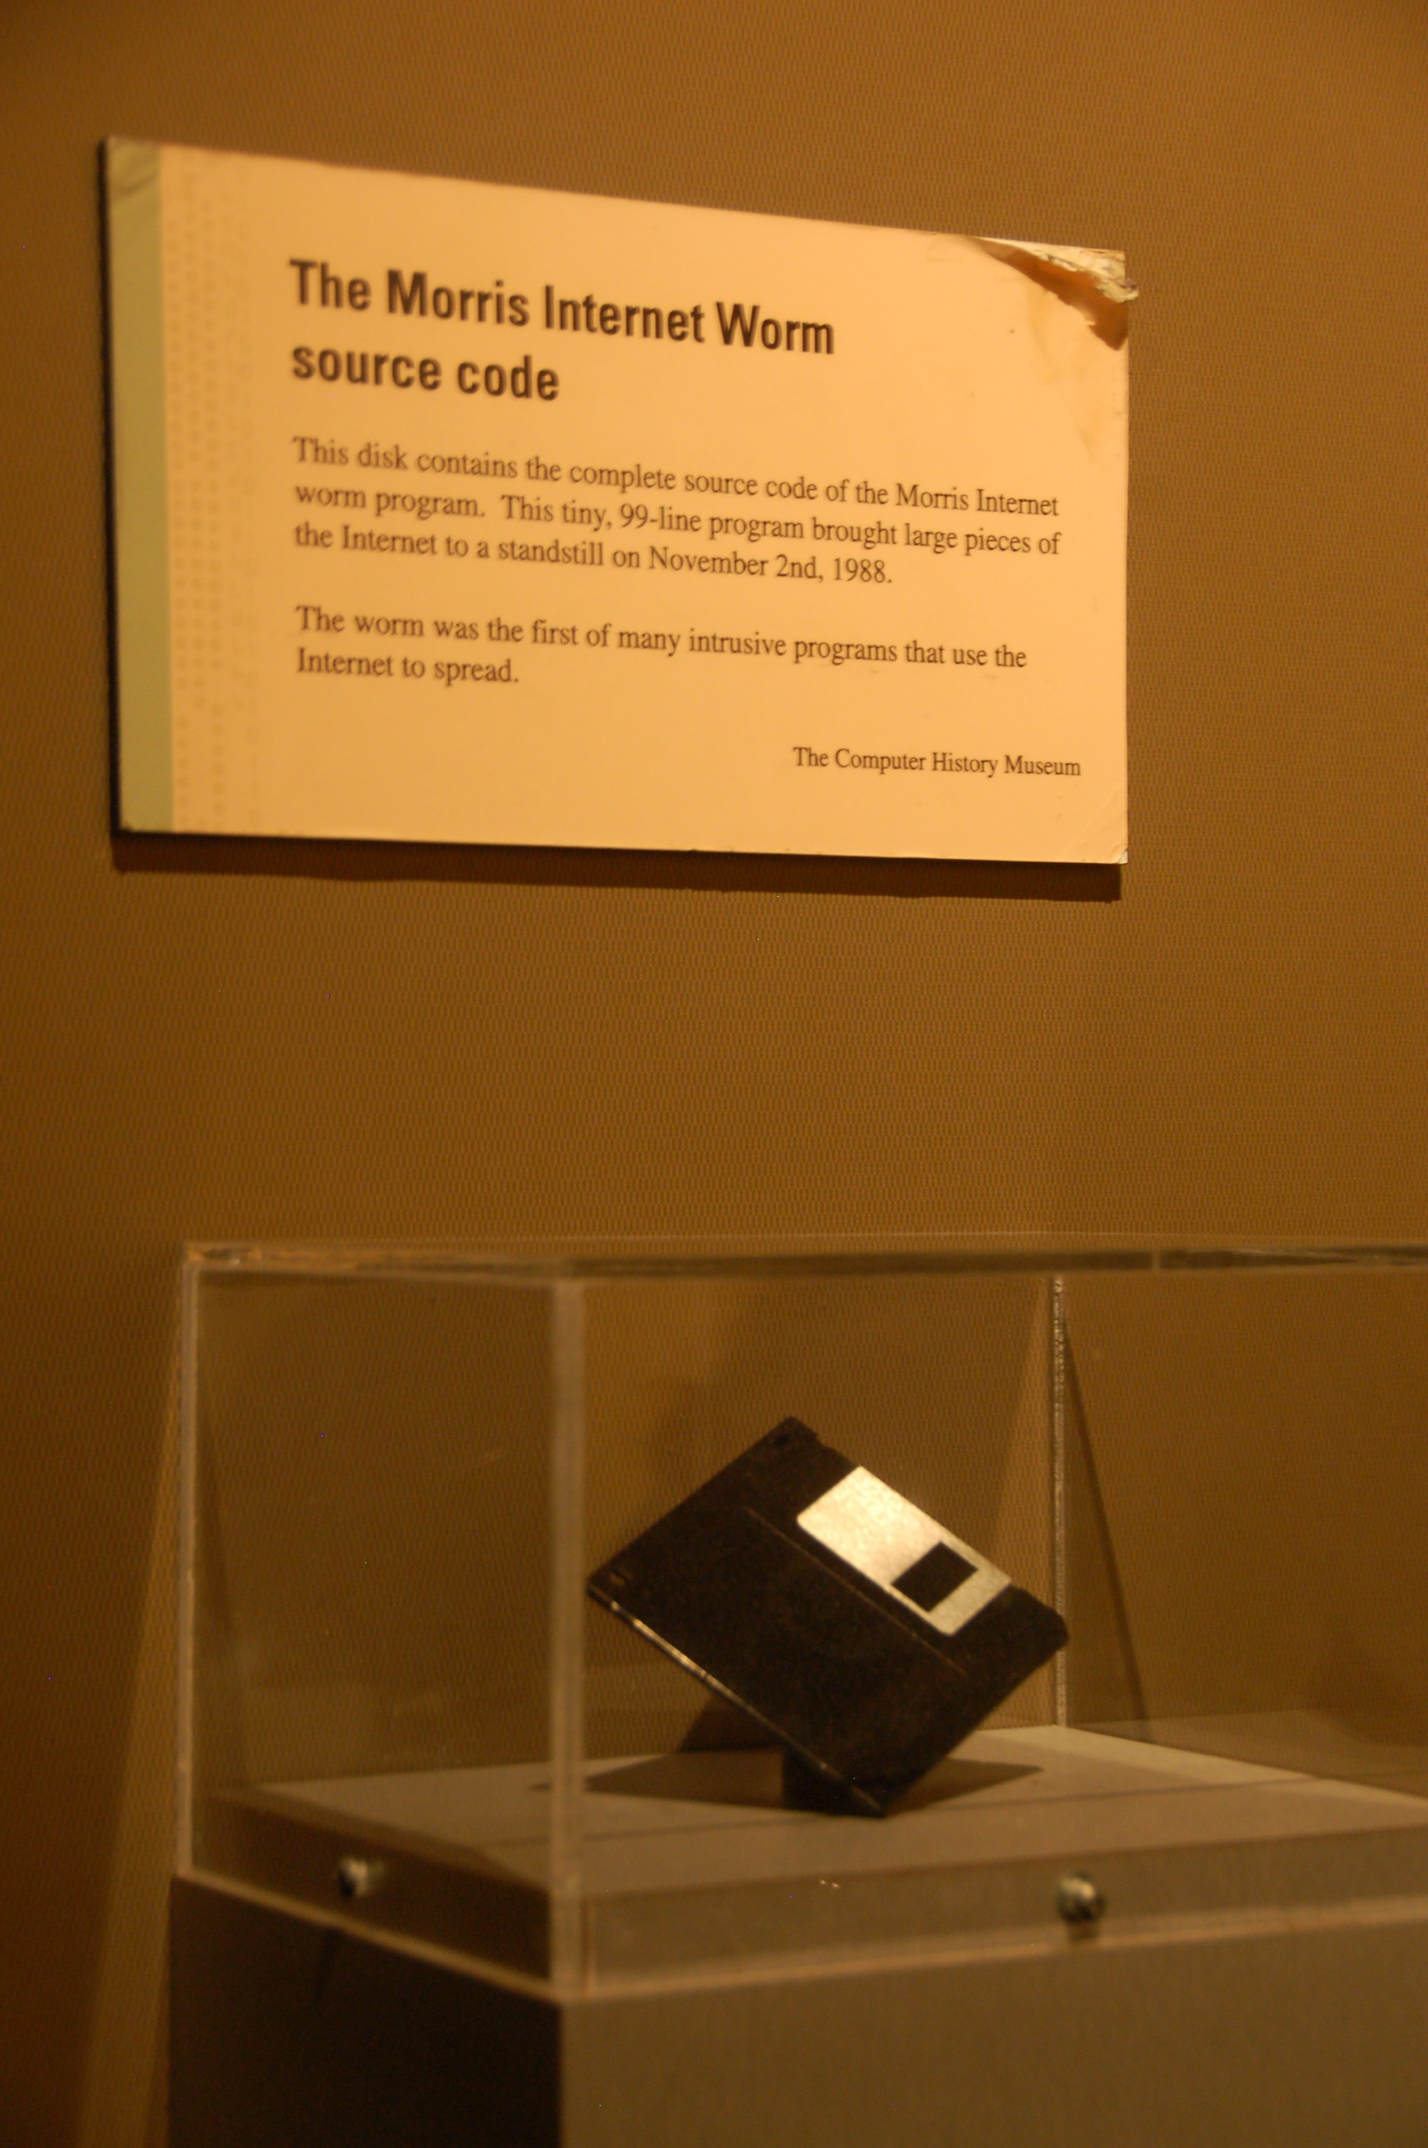
Security Concept: Code Injection
Code injection was used in one of the earliest documented exploits: the Morris worm.
Among other attack vectors, overflowed stack buffer in the fingerd service.
Injected shellcode to gain a foothold on the machine.
Scanned adjacent hosts and infected them to propagate the worm.
Shut down the internet.
Try it yourself! https://blog.rapid7.com/2019/01/02/the-ghost-of-exploits-past-a-deep-dive-into-the-morris-worm/

